Slide 1

Machine Learning
Session 1

Slide 2




Session 1
Introduction to Machine Learning.
History of Machine Learning.
Why ML.
Applications of ML.
Algorithms on ML.
------BREAK-----
Python tutorial
Model representation, Hypothesis function, Cost Function(Mean square Error).
Grow Through

Slide 3
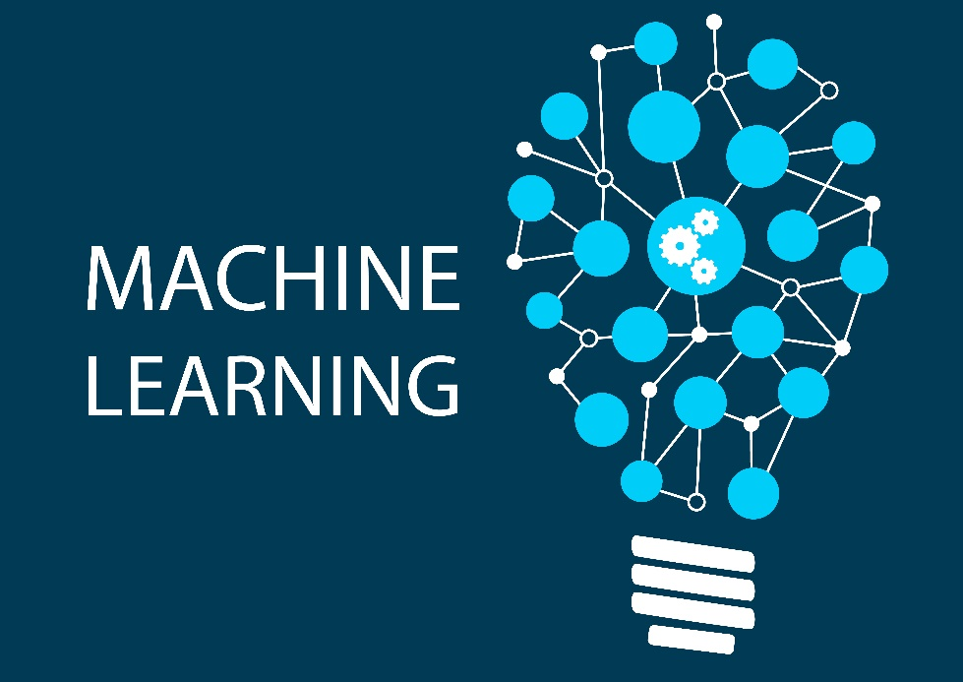
Session 1
Intro to ML
the study of computer algorithms that improve automatically through experience.
Machine Learning is a subset of artificial intelligence.
Field of study that gives computers the ability to learn without being explicitly programmed.
Grow Through

Slide 4
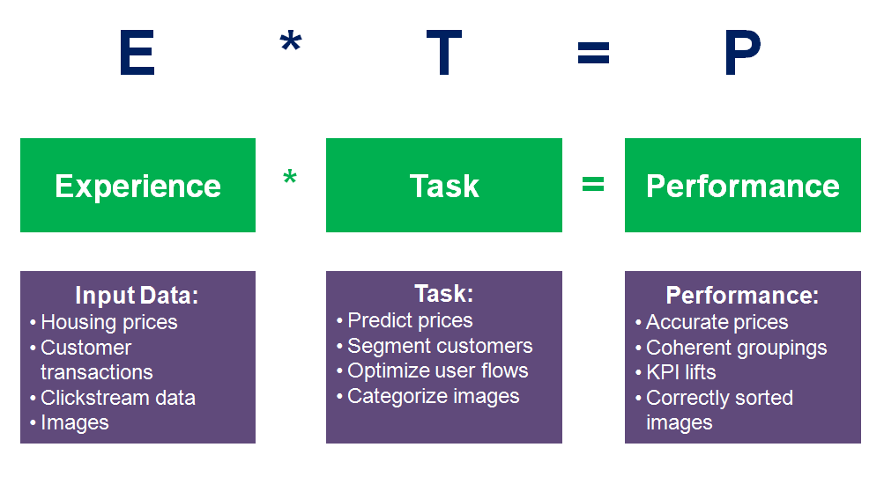
Session 1
Intro to ML
Tom Mitchell (1998) Well-posed Learning Problem: A computer program is said to learn from experience E with respect to some task T and some performance measure P, if its performance on T, as measured by P, improves with experience E.
Grow Through

Slide 5
Session 1
Intro to ML
EX. Suppose your image program watches which image you do or do not mark as human detected, and based on that learns how to better detect. What is the task T,P and E in this setting?
Classifying images as human detected or not.
Watching images that contains humans or not.
The number (or fraction) of images correctly classified.
None of the above—this is not a machine learning problem.
T
E
P
Grow Through

Slide 6
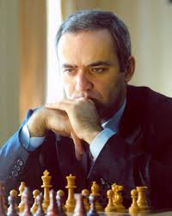
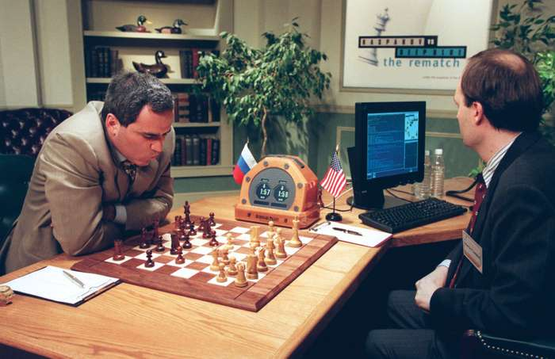
Session 1
Intro to ML
The struggle between computer of IBM and Garry Kasparov(the youngest world champion in chess) in 1997 and the computer could beat Kasparov after 5 times of lose and studying more than (700000) game of chess .
Grow Through

Slide 7
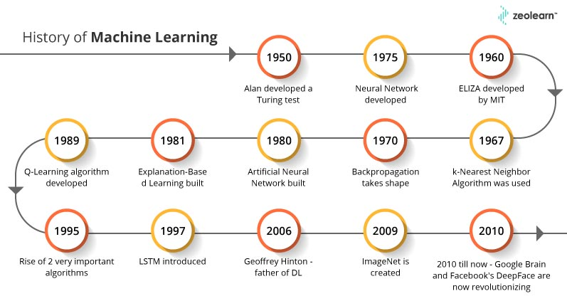
Session 1
History of ML
Grow Through

Slide 8
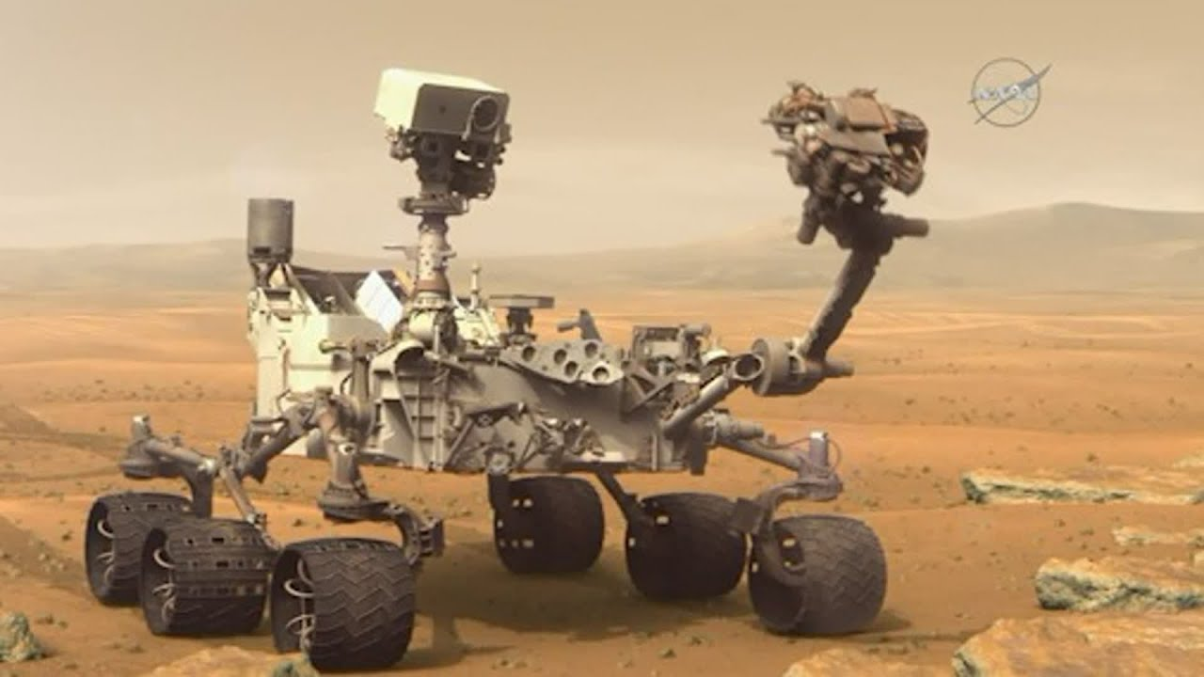
Session 1
Why ML?!
Machine learning is useful when human expertise doesn’t exist like navigation in mars.
Solutions changes in time like in communication networks base stations.
Human can’t express their expertise like blind people use speech recognition.
Grow Through

Slide 9
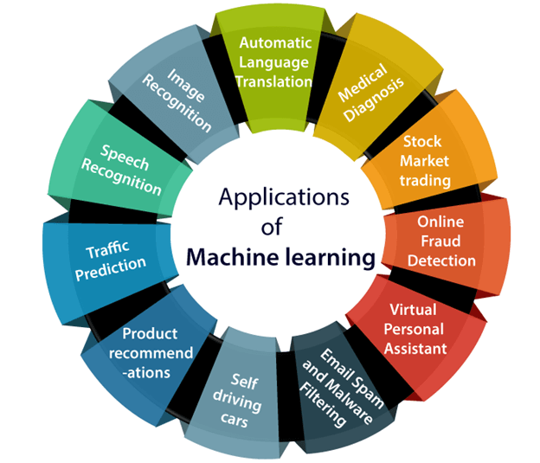
Session 1
Applications of
Applications of ML
We are using machine learning in our daily life even without knowing it such as Google Maps, Google assistant, Alexa, etc.
Grow Through

Slide 10
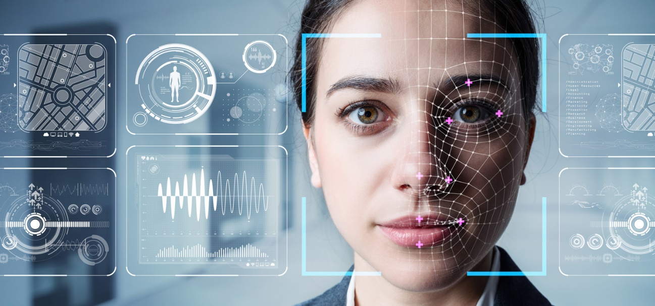
Session 1
Image Recognition
It is used to identify objects, persons, places, digital images, etc like in facebook , Automatic friend tagging suggestion as when we upload a photo with friend it suggest his name
In our smart phones the camera detect our faces and make authentication
Grow Through

Slide 11
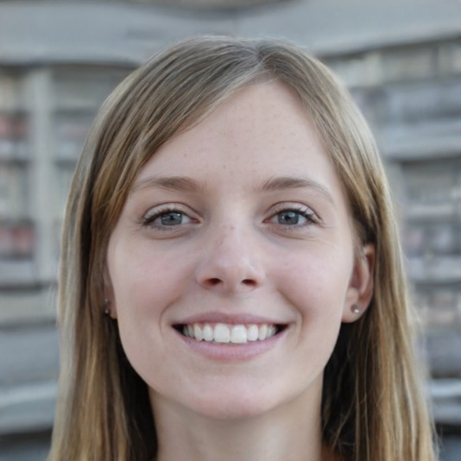
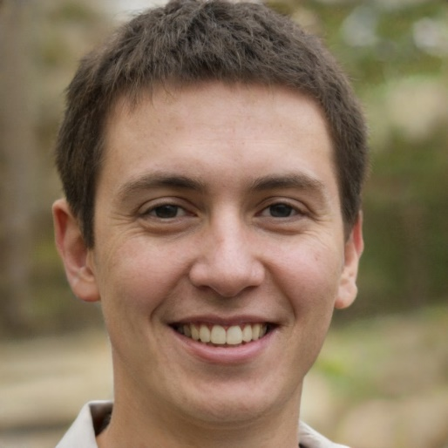
Session 1
Image Recognition
this person doesn't exist web site NVIDIA uses these person in simulations instead of copyrighted photos
https://thispersondoesnotexist.com/
-Also in terrorism
- Facebook trend about child challlenge
Grow Through

Slide 12
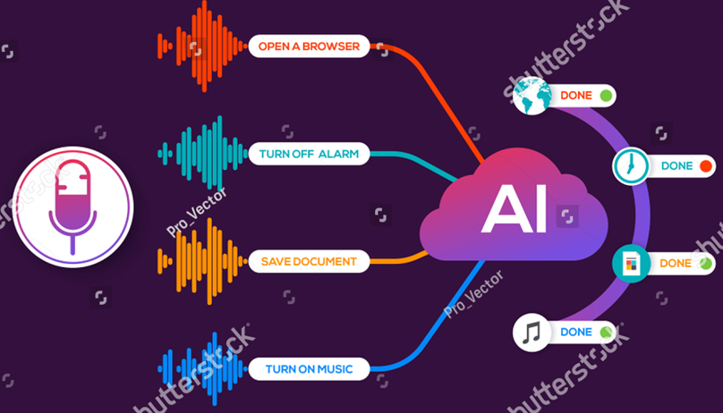
Session 1
Speech recognition
It is a process of converting voice instructions into text, and it is also known as Speech to text.
- We see this application in google assistant option search by voice it helps disabled people like the blind.
Grow Through

Slide 13

Session 1
Product recommendations
- companies such as Amazon, Netflix and many others depends on machine learning in their recommendations
- We can see that clearly between google and YouTube the search engine informed Youtube about your interests to view the suitable advertisement
- And wee can’t forget Netflix earns 1 million dollars from their prediction to the favourite movies to the users
Grow Through

Slide 14
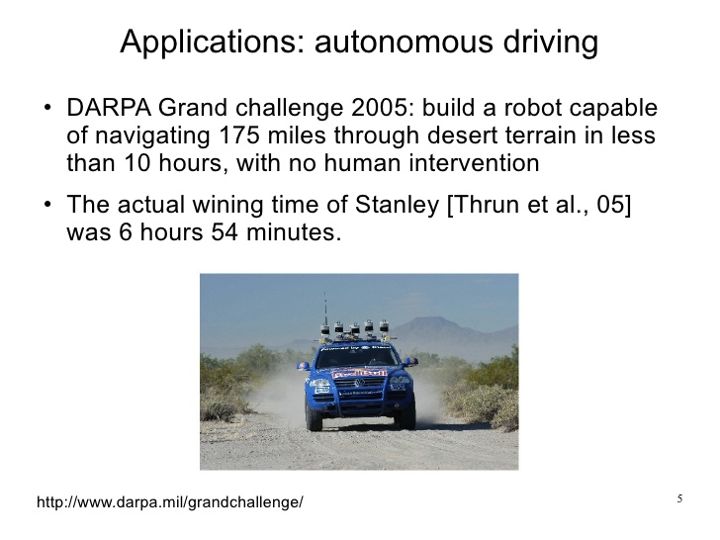
Session 1
As we seen in Tesla which is the most interested company with this field It is using unsupervised learning method to train the car models to detect people and objects while driving.
Self driving car
- The car of Vagin Voiex in 2005 which was having a robot can navigate 175miles in desert terrain in less than 10 hours and actually winning in 6 hours 54 minutes.
Grow Through

Slide 15
Session 1
Automatic Language Translation
As in the app Google Translation the option of automatic translation it recognize the language whatever it was and that help you in travelling to new places
In 2005 google translation studied two billion word(2000000000) to make efficiently
Grow Through

Slide 16
Session 1
Algorithms
Supervised learning
Unsupervised learning
Others: Reinforcement learning, recommender systems.
Also talk about: Practical advice for applying learning algorithms.
Grow Through

Slide 17
Session 1
Supervised learning
In supervised learning, we are given a data set and already know what our correct output should look like, having the idea that there is a relationship between the input and the output.
Supervised learning problems are categorized into "regression" and "classification" problems. In a regression problem, we are trying to predict results within a continuous output, meaning that we are trying to map input variables to some continuous function. In a classification problem, we are instead trying to predict results in a discrete output. In other words, we are trying to map input variables into discrete categories.
Grow Through

Slide 18
Session 1
Supervised learning
Example 1:
Given data about the size of houses on the real estate market, try to predict their price. Price as a function of size is a continuous output, so this is a regression problem.
We could turn this example into a classification problem by instead making our output about whether the house "sells for more or less than the asking price." Here we are classifying the houses based on price into two discrete categories.
Grow Through

Slide 19
Session 1
Supervised learning
Example 2:
Regression - Given a picture of a person, we have to predict their age on the basis of the given picture
Classification - Given a patient with a tumor, we have to predict whether the tumor is malignant or benign.
Grow Through

Slide 20
Quiz:
Classify which problem is regression or classification.
Problem 1: You have a large restaurant. You want to predict how much profit over the next 3 months.
Problem 2: You’ve a bank and for each account decide if this account is VIP/normal.
Treat both as classification problems.
Treat problem 1 as a classification problem, problem 2 as a regression problem.
Treat problem 1 as a regression problem, problem 2 as a classification problem.
Treat both as regression problems.
Grow Through

Slide 21
Session 1
Unsupervised learning
Unsupervised learning allows us to approach problems with little or no idea what our results should look like. We can derive structure from data where we don't necessarily know the effect of the variables.
We can derive this structure by clustering the data based on relationships among the variables in the data.
With unsupervised learning there is no feedback based on the prediction results.
Grow Through

Slide 22
Session 1
Unsupervised learning
Types:
Clustering: Take a collection of 1,000,000 different genes, and find a way to automatically group these genes into groups that are somehow similar or related by different variables, such as lifespan, location, roles, and so on.
Non-clustering: The "Cocktail Party Algorithm", allows you to find structure in a chaotic environment. (i.e. identifying individual voices and music from a mesh of sounds at a cocktail party).
Grow Through

Slide 23
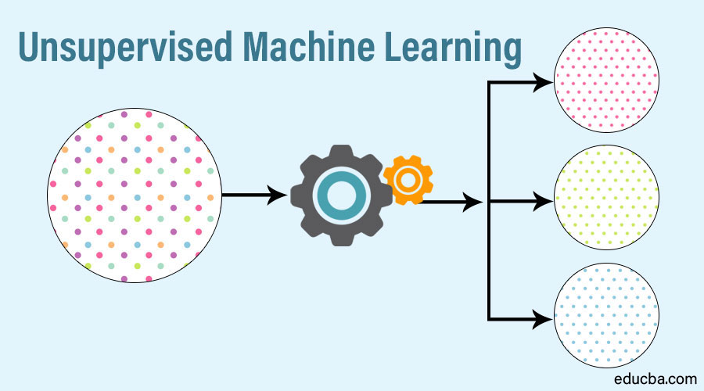
Example:
Grow Through

Slide 24
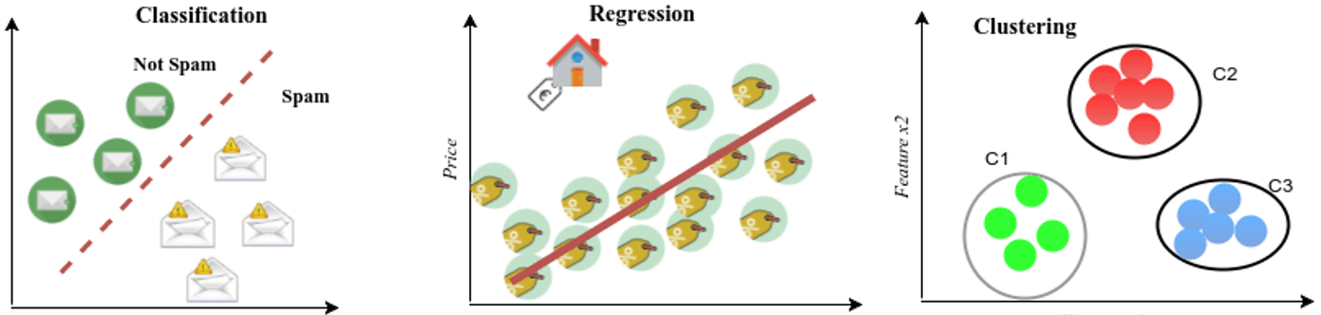
Example:
Grow Through

Slide 25
Quiz:
Of the following examples, which would you address using an
unsupervised learning algorithm? (Check all that apply.)
Given email labeled as spam/not spam, learn a spam filter.
Given a set of news articles found on the web, group them into set of articles about the same story.
Given a database of customer data, automatically discover market
Given a dataset of patients diagnosed as either having diabetes or not, learn to classify new patients as having diabetes or not.
Grow Through

Slide 26
Break
Grow Through

Slide 27
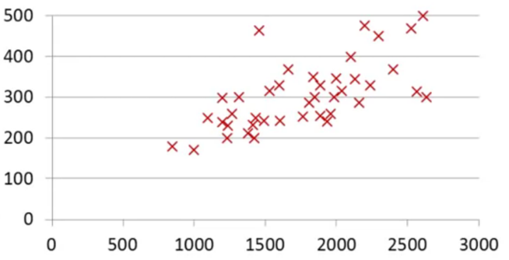
Session 1
Model Representation
Housing prices:
Supervised Linear Regression problem with one variable
Price
(dollars)
Size(feet)
Grow Through

Slide 28
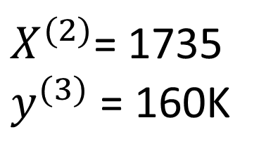
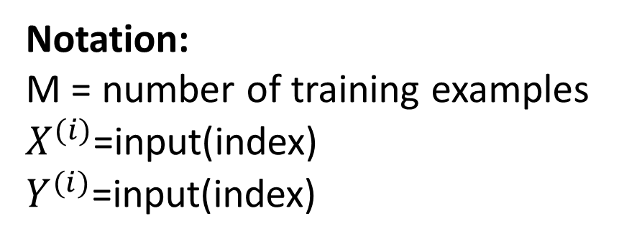
Training set :
Size | price
2000 | 400K
1735 | 310K
960 | 160K
600 | 120K
Notation:
M = number of training examples
$X^{(i)}$=input(index)
$Y^{(i)}$=input(index)
$X^{(2)}$= 1735
$y^{(3)}$ = 160K
Grow Through

Slide 29
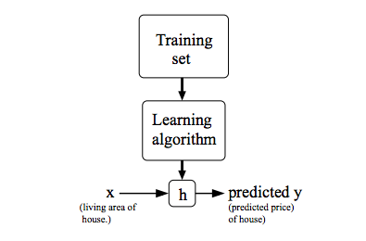

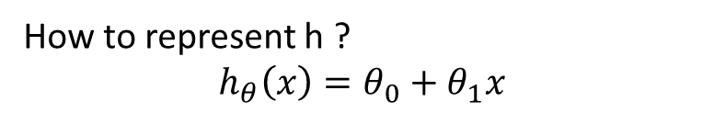
Session 1
Model Representation
How to represent h ?
$$h_{θ}\left(x\right)=θ_{0}+θ_{1}x$$
Grow Through

Slide 30
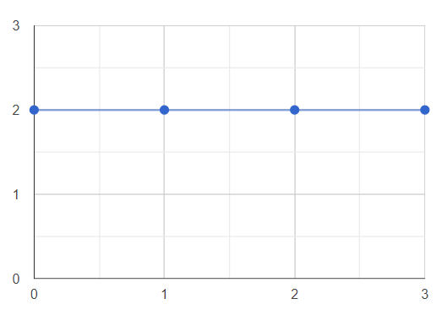
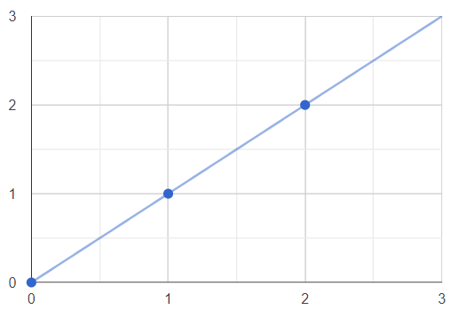
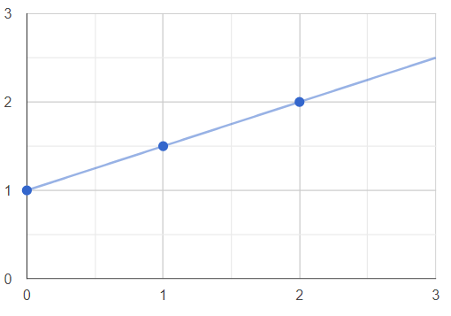
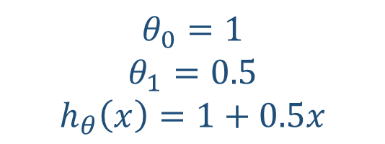
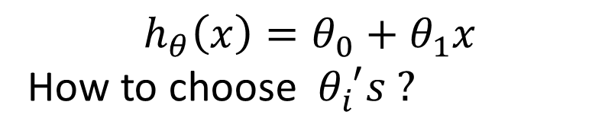
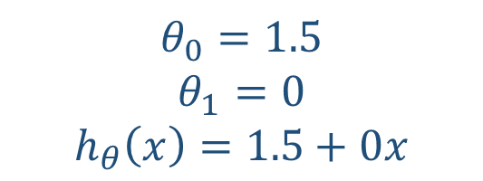
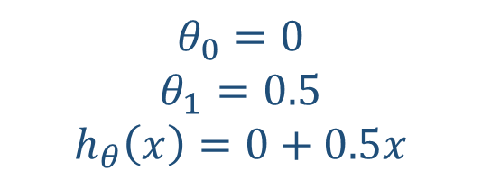
Hypothesis function:
$$h_{θ}\left(x\right)=θ_{0}+θ_{1}x$$
How to choose $θ_{i}^{ ′}s ?$
$$θ_{0}=1.5$$
$$θ_{1}=0$$
$$h_{θ}\left(x\right)=1.5+0x$$
$$θ_{0}=0$$
$$θ_{1}=0.5$$
$$h_{θ}\left(x\right)=0+0.5x$$
$$θ_{0}=1$$
$$θ_{1}=0.5$$
$$h_{θ}\left(x\right)=1+0.5x$$
Grow Through

Slide 31
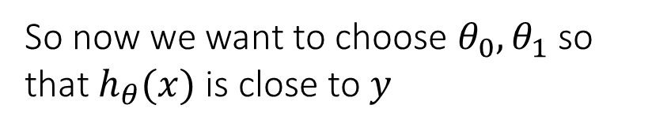
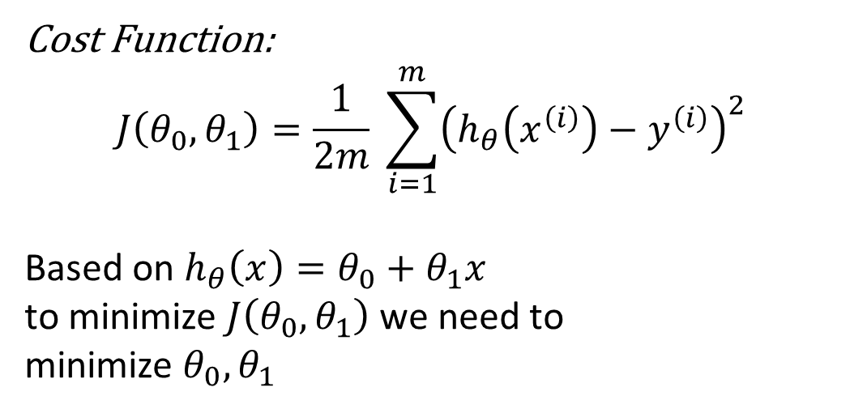
Session 1
Cost Function(Mean Square Error)
Cost Function:
$$J\left(θ_{0},θ_{1}\right)=\frac{1}{2m} \sum_{i=1}^{m}{{\left(h_{θ}\left(x^{\left(i\right)}\right)−y^{\left(i\right)}\right)}^{2}}$$
Based on $h_{θ}\left(x\right)=θ_{0}+θ_{1}x$
to minimize $J\left(θ_{0},θ_{1}\right)$ we need to
minimize $θ_{0},θ_{1}$
So now we want to choose $θ_{0},θ_{1}$so that $h_{θ}(x)$ is close to $y$
Grow Through

Slide 32
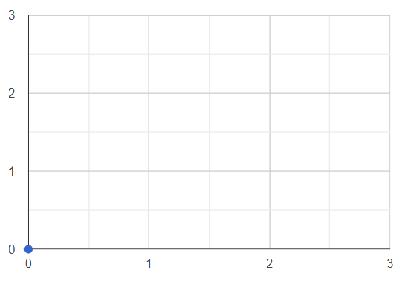
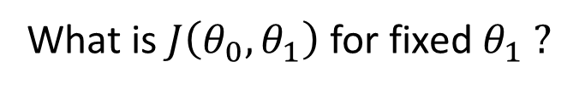


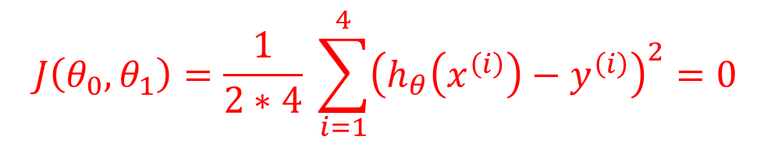



Linear Regression problem with one variable
$$h_{θ}\left(x\right)$$
$$J\left(θ_{1}\right)$$
Y
$$J\left(θ_{1}\right)$$
$$θ_{1}=1$$
X
$$θ_{1}$$
What is $J\left(θ_{0},θ_{1}\right)$ for fixed $θ_{1} ?$
$$J\left(θ_{0},θ_{1}\right)=\frac{1}{2∗4} \sum_{i=1}^{4}{{\left(h_{θ}\left(x^{\left(i\right)}\right)−y^{\left(i\right)}\right)}^{2}=0}$$
Grow Through

Slide 33


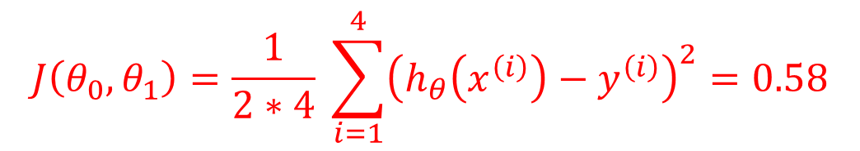

Linear Regression problem with one variable
$$h_{θ}\left(x\right)$$
$$J\left(θ_{1}\right)$$
$$θ_{1}=0.5$$
Y
$$J\left(θ_{1}\right)$$
X
$$θ_{1}$$
What is $J\left(θ_{0},θ_{1}\right)$ for fixed $θ_{1} ?$
$$J\left(θ_{0},θ_{1}\right)=\frac{1}{2∗4} \sum_{i=1}^{4}{{\left(h_{θ}\left(x^{\left(i\right)}\right)−y^{\left(i\right)}\right)}^{2}=0.58}$$
Grow Through

Slide 34
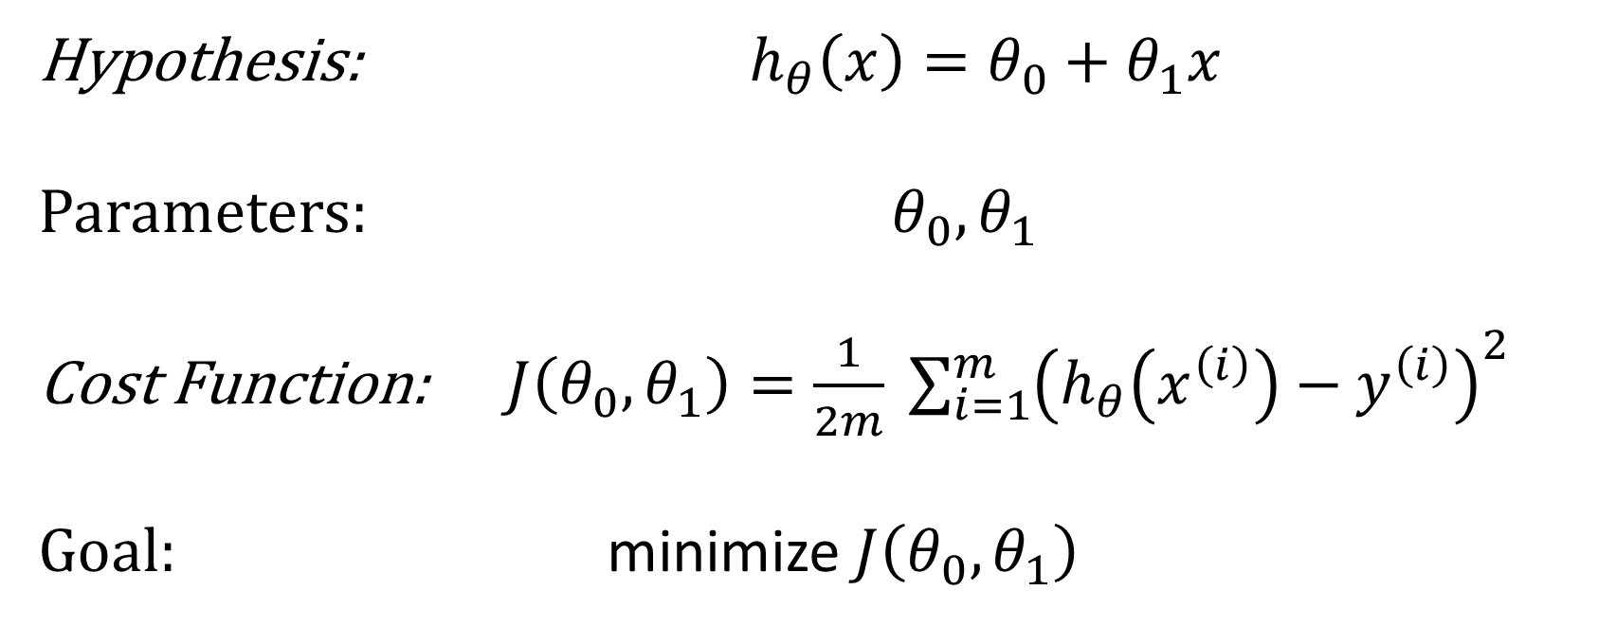
Linear Regression problem with one variable
Hypothesis: $h_{θ}\left(x\right)=θ_{0}+θ_{1}x$
Parameters: $θ_{0},θ_{1}$
Cost Function: $J\left(θ_{0},θ_{1}\right)=\frac{1}{2m} \sum_{i=1}^{m}{{\left(h_{θ}\left(x^{\left(i\right)}\right)−y^{\left(i\right)}\right)}^{2}}$
Goal: minimize $J\left(θ_{0},θ_{1}\right)$
Grow Through

Slide 35
Goodbye
Grow Through

